Slide 1

noWorkflow: Capturing and Analyzing Provenance of Scripts
Leonardo Murta
Vanessa Braganholo
Fernando Chirigati
David Koop
Juliana Freire
Fluminense Federal University, Brazil
New York University, USA

Slide 2
Outline
Motivation
Related Work
Issues regarding provenance of scripts
Provenance Representation Types
Capture Granularity
noWorkflow
Capture
Analysis
Final Remarks

Slide 3
Scientific Experiments
Workflow Systems
Scripts
Notes:
There has been lots of work on Workflow Systems aiming at capturing and analyzing provenance data of experiments that are run under these systems. However, lots of scientists still use scripts to run their experiments, and do not want, or simply can’t move them to workflow systems.

Slide 4
Workflow Systems vs. Scripts
Scientists may prefer to use scripts instead of Workflow Management Systems
Moving to these systems requires a steep learning curve
Wrapping scripts and libraries may be time-consuming
It may not be possible to integrate some third-party code and tools
Notes:
There are several reasons for this.
First, …

Slide 5
Challenges
Provenance capture outside of a workflow management system is challenging
There is no control over the evolution of the experiment
Scripts can encode a control flow
Notes:
These scientists still need provenance data about their experiments. However, capturing provenance outside a workflow system is challenging.

Slide 6
Problem
How to cope with these challenges while providing a transparent and non-intrusive approach to capture provenance of scripts?

Slide 7
Related Work
OS-Level Tools – ES3, Burrito, and PASS [1,2,3]
They monitor and track system calls
Provenance at the process level – it is difficult to reconcile provenance information with script definition (e.g., function calls)
Some do not support reproducibility
Provenance API for Python [4]
API and client library capture provenance for Python scripts
Intrusive – it requires users to change their scripts and include specific API method calls
Verifiable Computational Result – VCR [5]
Results are assigned unique identifiers
Intrusive – it requires the use of a specific API
Notes:
This problem has been investigated in the literature for a while.

Slide 8
Related Work
Sumatra [6]
It collects provenance from Python scripts and their dependencies
It assumes that the code lives in a version control system
ProvenanceCurious [7]
It captures provenance from Python scripts using AST analysis
Non-transparent – it requires input from users, for every operation, about data persistency
Tariq et al. – use of LLVM compiler framework [8]
It captures provenance at each function entry and exit
It relies on a compiler: it only captures static information
Functions are black-boxes: variables inside functions are ignored
Notes:
ProvenanceCurious requires the user to inform, for each operation, which one reads or writes persistent data.
LLVM – Low Level Virtual Machine

Slide 9
noWorkflow = not only Workflow
Notes:
Our approach overcomes these limitations. It is called noWorkflow, resembling the noSQL nomenclature, and stands for not only workflows. The key idea is that experiments that are outside workflow systems can still benefit from provenance capabilities.
However, before introducing noWorkflow, let’s talk a little bit about types of Provenance.

Slide 10
Provenance of Workflows
Prospective
Retrospective
Notes:
The wrapping required by a WfMS to orchestrate the execution of modules from a tool or library naturally creates a level of abstraction for the execution: the module is a black box and its details are hidden. Because the wrapped libraries are integrated with the WfMS, it is possible for the system to track and control them, e.g., to detect that a wrapped library has changed and to upgrade the workflows accordingly.

Slide 11
1. import csv
2. import sys
3. import matplotlib.pyplot as plt
4. from simulator import simulate
5.
6. def run_simulation(data_a, data_b):
7. a = csv_read(data_a)
8. b = csv_read(data_b)
9. data = simulate(a, b)
10. return data
11.
12. def csv_read(f):
13. reader = csv.reader(open(f, 'rU'), delimiter=':')
14. data = []
15. for row in reader:
16. data.append(row)
17. return data
18.
19. def extract_column(data, column):
20. col_data = []
21. for row in data:
22. col_data.append(float(row[column]))
23. return col_data
24.
25. def plot(data):
26. t = extract_column(data, 0)
27. p = extract_column(data, 1)
28. plt.scatter(t, p, marker='o')
29. plt.xlabel('Temperature')
30. plt.ylabel('Precipitation')
31. plt.savefig('output.png')
32.
33. data_a = sys.argv[1]
34. data_b = sys.argv[2]
35. data = run_simulation(data_a, data_b)
36. plot(data)
Notes:
This script depends on 703 distinct modules, although only four are explicitly declared. Suppose we run the experiment script once and obtain a result. If later, software is installed (or upgraded) that silently updates one of the modules on which the experiment script depends, the next execution may produce a different result, even though its source code remains unchanged. If these dependencies are not systematically captured, it may be difficult to understand why results are different between executions that are apparently identical. The provenance needed here is neither prospective nor retrospective, and it needs to be captured right before execution. Borrowing terms from software engineering, where software goes through three phases, i.e., definition , deployment , and execution [9], we define three types of provenance needed for scripts

Slide 12
Provenance of Scripts
Provenance of Workflows
Prospective
Retrospective
Definition Provenance
Deployment Provenance
Execution Provenance
Notes:
- Definition Provenance captures the structure of the script, including function definitions, their arguments, and function calls; it corresponds to prospective
provenance.
- Deployment Provenance captures the execution environment, including information about the operating system, environment variables, and libraries on
which the script depends. As discussed before, this may change from one execution to another, even if the source code remains the same. In addition, it
extends beyond dependencies a programmer explicitly defines, and the concrete library versions that are loaded depend on the deployment environment.
- Execution Provenance captures the execution log for the script (e.g., function activations, argument values, and return values); it corresponds to retrospective
provenance.

Slide 13
Granularity
Workflows: activities
Scripts
OS Level
High volume of very fine grained information
Difficult to connect with the script specification
Entire Script
Black Box
Impossible to know which function contributed to the generation of a given data
Functions
May still be overwhelming
We opted for capturing user-defined function calls

Slide 14
noWorkflow
It captures provenance of Python scripts
It is transparent and non-intrusive
It transparently captures provenance of scripts
It does not require a version control system or an instrumented environment
Notes:
Although our techniques are general, we implemented noWorkflow to capture provenance of Python scritps, since this is a very common language among scientists

Slide 15
Usage
Instead of running
python <script>
Run
now run <script>

Slide 16
Reproducibility
It can be used for both reproducibility modes
Planning for reproducibility
Replacement of Python for noWorkflow
Use of noWorkflow for the entire experiment’s lifetime
Reproducibility after the fact
Capture of a run after the experiment is ready for publication

Slide 17
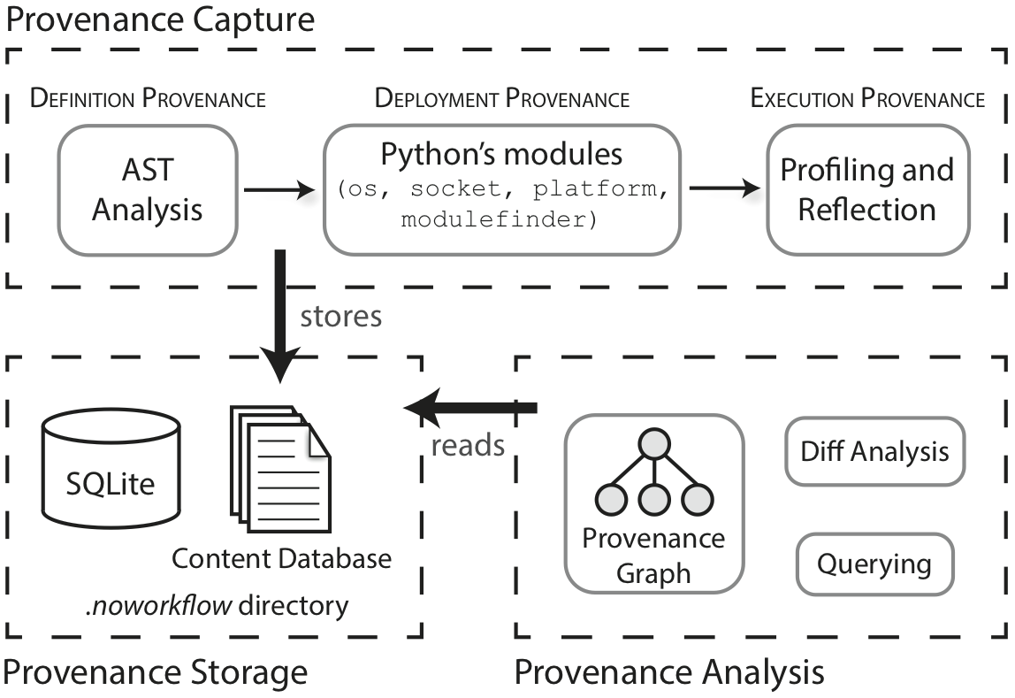
Architecture
Notes:
The architecture of noWorkflow is divided in three main layers.

Slide 18
Architecture
environment variables and library dependencies: capture right before execution
retrospective provenance: capture during execution; e.g.: function activations, argument values, return values, time, content of input files, …
prospective provenance: capture before execution; e.g.: user-defined functions (source code), function calls, arguments, global variables

Slide 19
Architecture
provenance information
file contents

Slide 20
Architecture
Notes:
The architecture of noWorkflow is divided in three main layers.

Slide 21
Definition Provenance
We use the AST of the script to identify
Function definitions
Function calls
Arguments
Global Variables

Slide 22
def run_simulation(data_a, data_b):
a = csv_read(data_a)
b = csv_read(data_b)
data = simulate(a, b)
return data
Function and script source codes are stored in a content database
File name is the SHA1 hash code
Due to hash codes, there is no redundancy in the content database – if something is already there, it is not stored again

Slide 23
def run_simulation(data_a, data_b):
a = csv_read(data_a)
b = csv_read(data_b)
data = simulate(a, b)
return data
Function definitions, function calls, arguments and global variables are stored in a SQLite database
All this information is associated with the experiment trial id
Notes:
In this example, noWorkflow would capture the run_simulation function definition, together with its arguments data_a and data_b. It would also capture that run_simulation calls functions csv_read and simulate, and their respective parameters.
This is all captured before running the script.
Trial id= execution number automatically generated by noWorkflow

Slide 24
Deployment Provenance
Environment
Use Python libraries os, socket and platform
Module dependencies
Use Python modulefinder library to capture the transitive closure of all module dependencies
noWorkflow associates this information with the trial id and stores it in the SQLite database
Source code of the modules are stored in the content database
Notes:
Recall that our simple example depends on 703 modules!

Slide 25
Execution Provenance
noWorkflow captures
Function activations
Argument values
Return values
Start and Finish time for each function activation
Content of all files manipulated during execution
All of this is stored in the SQLite database, except for the file contents, which are stored in the content database
Notes:
Notice the term “function activation” here, that is different from function call. Function activation refers to when functions are actually executed during runtime.

Slide 26
Execution Provenance
noWorkflow uses the Python profiling API to capture function activations
It registers itself as a listener and is notified of every function activation by the profiler
Our example has 156,086 function activations, which is a lot for the scientist to make sense of – we thus only store function activations related to user-defined functions by default (users may choose to change this when invoking noWorkflow)

Slide 27
def csv_read(f):
reader = csv.reader(open(f, 'rU'), delimiter=':')
data = []
for row in reader:
data.append(row)
return data
Function activations of data.append are captured, but
activations of functions called by data.append are not
Notes:
In this example, the data.append function is called several times, because it is inside a for loop. This information is kept by noWorkflow because data.append is called by a user-defined function. However, functions called by data.append are not registered by noWorkflow by default. In our opinion, this is not a problem because the scientist would not know those other functions anyway, and it would be hard to make sense of all of that extra data.

Slide 28
def plot(data):
t = extract_column(data, 0)
p = extract_column(data, 1)
plt.scatter(t, p, marker='o')
plt.xlabel('Temperature')
plt.ylabel('Precipitation')
plt.savefig('output.png')
Possible miss of file write
Notes:
A possible side-effect of this default behavior is related to missing file open function calls. In this example, savefig call open and writes to the file output.png, but since it is not a user-defined function, the call to the open function would no be captured.

Slide 29
Execution Provenance
noWorkflow uses reflection to capture file contents during execution
It implements a new open function that overwrites the open system call
We capture the file content before and after each activation of the function that called open
This allow us to know which function altered a given file
Notes:
To solve this problem, noWorkflow uses…

Slide 30
Architecture
contrasting different trials
Prolog
visualization

Slide 31
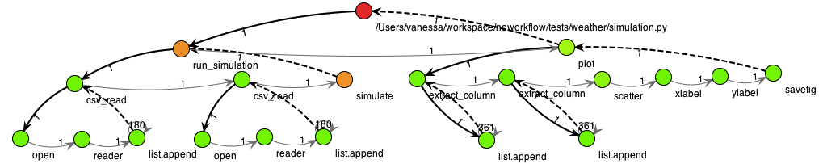
Graph-Based Analysis
Notes:
This graph shows function activations, and groups then if they belong to the same context (for example, if they belong to the same loop, as list_append, in the example). When a function calls another function, there is a solid black arrow from the caller node to the called node. Gray arrows represent sequence (that is, function simulate is called after csv_read), and dashed arrows represent return points (for example, when simulate ends, the control flow returns to run_simulation).
Nodes are colored according to a traffic light scale. Green nodes are used for functions that run fast, and red nodes represent functions that run slowly.

Slide 32
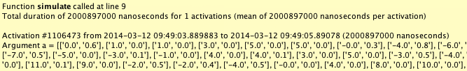
Graph-Based Analysis
Notes:
A tooltip window provides more detailed information about each vertex, including descriptions of each function activation.

Slide 33
Diff-Based Analysis
$ now diff -m -e 1 1002
[now] trial diff:
start changed from 2014-03-09 00:07:10.297690 to 2014-03-12 09:48:26.382903
finish changed from 2014-03-09 00:07:32.138009 to 2014-03-12 09:49:06.703837
code_hash changed from ff426a46f060cc9c081329e82feca6e1ada87e80 to 3461fe48c17619faeb81a6334567a47a162c7788
[now] 1 modules added:
Name: simulator
Version: None
Path: /Users/vanessa/workspace/noworkflow/tests/weather/simulator.py
Code hash: bff078cc790fd5a9e0627bf00882d1d02d9cc6e5
[now] 0 modules removed:
[now] 0 modules replaced:
Notes:
Our diff-based analysis is capable of comparing two different trials. Currently, our diff based analysis is able to detect differences in modules and on the environment, as a proof of concept. Other comparisons can be easily added in the future.
In this example, we are comparing trial 1 and 1002, and we can easily see new module dependencies,

Slide 34
Diff-Based Analysis
[now] 1 environment attributes added:
OLDPWD: /Users/vanessa/workspace/noworkflow/tests
[now] 0 environment attributes removed:
[now] 6 environment attributes replaced:
Environment attribute SSH_AUTH_SOCK changed from /tmp/launch-we4bLA/Listeners to /tmp/launch-xxMmPo/Listeners
Environment attribute SHLVL changed from 2 to 1
Environment attribute Apple_PubSub_Socket_Render changed from /tmp/launch-zaPg21/Render to /tmp/launch-HMkucM/Render
Environment attribute DISPLAY changed from /tmp/launch-BGgFBr/org.macosforge.xquartz:0 to /tmp/launch-ZPlHHA/org.macosforge.xquartz:0
Environment attribute PID changed from 11172 to 11737
Environment attribute TERM_SESSION_ID changed from 9BF314A4-4244-4BCF-B53D-115B640C794B to E0DC8582-56B5-4AB2-AD6F-EF63750A002C
Notes:
And environment changes.

Slide 35
Query-Based Analysis
Provenance data is exported as Prolog facts
$ now export
A specialist user may define queries to be used by scientists
Predefined rules can be exported together with the facts by noWorkflow (now export –r)
Since we export the Prolog facts, any Prolog engine may be used

Slide 36
Examples
1 ?- changed(File).
File = 'output.png'
false.
2 ?- access_influence(File, 'output.png').
File = 'data1.dat'
File = 'data2.dat'
false.
Notes:
Here we show two queries that were created by a specialist user using the predefined rules generated by noWorkflow. The first query finds out what files have changed during the execution of this trial.
The second query retrieves all files that may have influenced the change on file output.png. The rationale of the rule considers that a file $x$ influenced on a file $y$ if file $x$ was read before file $y$ was written. Also, file $y$ must have been written by a function that was activated after the function that read $x$.

Slide 37
Preliminary Experimental analysis
noWorkflow introduces some overhead during execution
Finding module dependencies is time consuming
To solve this, we allow the scientist to skip capturing module dependencies
More experiments are needed to analyze run-time and storage overhead

Slide 38
Final Remarks
noWorkflow is completely transparent and non intrusive
It does not require the scientist to modify her script
It provides three different ways of analysis: diff, query and graph
It simplifies reproducibility
Provenance is stored in a .noworkflow directory, which may be easily shared with collaborators
It eases the reasoning about the experimental process

Slide 39
Final Remarks
Future work
Show the script evolution over time
Provide caching capabilities for slow-running deterministic functions
Identify flaws in the script execution
…

Slide 40
Final Remarks
Available as Open Source at https://github.com/gems-uff/noworkflow
Want a demo? Come talk to me!

Slide 41
noWorkflow: Capturing and Analyzing Provenance of Scripts
Leonardo Murta
Vanessa Braganholo
Fernando Chirigati
David Koop
Juliana Freire
Universidade Federal Fluminense, Brazil
New York University, USA

Slide 42
References
[1] Frew, J., Metzger, D., Slaughter, P.: Automatic capture and reconstruction of computational provenance. Concurrency and Computation: Practice and Experience 20(5), 485–496 (2008)
[2] Guo, P.J., Seltzer, M.: BURRITO: Wrapping Your Lab Notebook in Computational Infrastructure. In: TaPP. pp. 7–7 (2012)
[3] Muniswamy-Reddy, K.K., Holland, D.A., Braun, U., Seltzer, M.: Provenance-aware storage systems. In: USENIX. pp. 4–4 (2006)
[4] Bochner, C., Gude, R., Schreiber, A.: A Python Library for Provenance Recording and Querying. In: IPAW. pp. 229–240 (2008)
[5] Gavish, M., Donoho, D.: A Universal Identifier for Computational Results. Procedia Computer Science 4, 637–647 (2011)
[6] Davison, A.: Automated Capture of Experiment Context for Easier Reproducibility in Computational Research. Computing in Science Engineering 14(4), 48–56 (2012)
[7] Huq, M.R., Apers, P.M.G., Wombacher, A.: ProvenanceCurious: a tool to infer data provenance from scripts. In: EDBT. pp. 765–768 (2013)
[8] Tariq, D., Ali, M., Gehani, A.: Towards automated collection of application-level data provenance. In: TaPP. pp. 1–5 (2012)

Slide 43
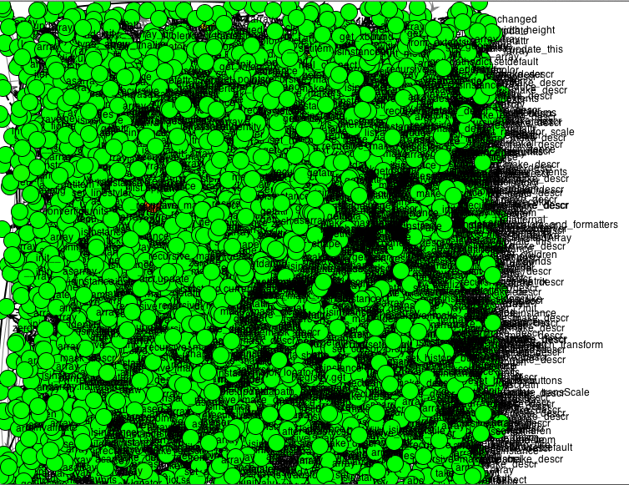
Notes:
Generated for all functions, with depth 10.
14404 function activations

